Slide 1
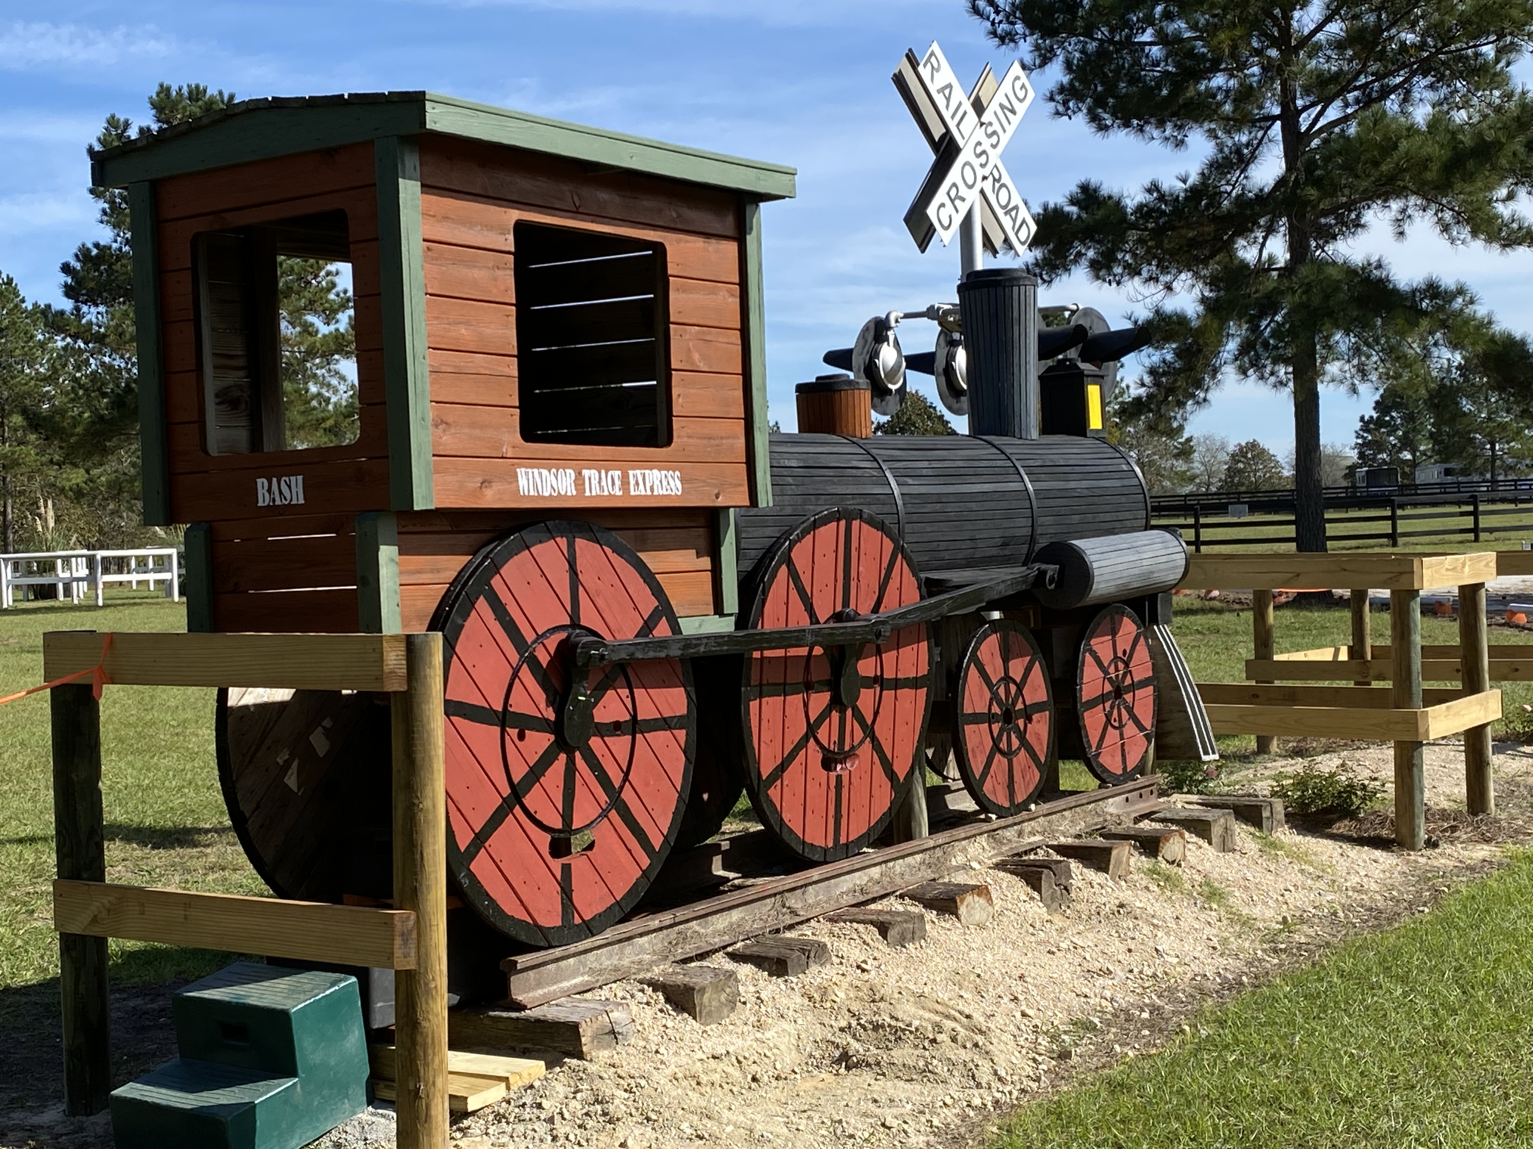
IN /OUT
WINDSOR TRACE CDE 2023
#1 The Windsor Trace Express
Training--ABC
VSE-PR—ABCD
Premlinary--ABCD
IT-ABCDE
NAC IT –ABCDE
VSE IT- ABCDE
NAC VSE IT- ABCDE
3 knockdowns
E
E
X
B
D
X
A
X
C

Slide 2
3m
IN
Windsor Trace 2023
#2 Jalapeno Dough Obstacle
Training--ABC
VSE-PR--ABCD
Prliminary-ABCD
IT-ABCDE
NAC IT- ABCDE
VSE IT—ABCDE
NAC VSE IT-ABCDE
C
OUT
D
E
B
A
B

Slide 3
IN /OUT
WINDSOR TRACE CDE 2023
#3 Dolphin Boy
C
C
D
X
NAC IT--ABCDE
NAC VSE IT-ABCDE
1 knockdown
A
E
E
C
A
B
B
D
Notes:
FIX FROG
FILL IN SINK HOLE

Slide 4
Windsor Trace 2023
#4 M & M Obstacle
IT-ABCDE
9 knockdowns
X
X
D
X
IN /OUT
B
X
X
X
E
A
X
C
X
X

Slide 5
WINDSOR TRACE CDE 2023
IN
Prliminary- ABCD
VSE Preliminary - ABCD
IT-ABCDE
VSE IT– ABCDE
NAC IT- ABCDE
NAC VSE IT- ABCDE
Prlim
# 5 Holy Moly!!
Forest
A
E
D
C
Forest
B
OUT

Slide 6
Windsor Trace 2023
#6 The Steinway
STEINWAY
A
E
TR- ABC
PR- ABCD
VSE-PR--ABCD
IT-ABCDE
NAC IT- ABCDE
VSE IT- ABCDE
NAC VSE IT- ABCDE
D
B
C
C
IN /OUT

Slide 7
WINDSOR TRACE CDE 2023
#7 Light House
TR- ABC
PR- ABCD
VSE-PR--ABCD
IT-ABCDE
NAC IT- ABCDE
VSE IT- ABCDE
NAC VSE IT- ABCDE
A
C
B
B
E
D
IN /OUT

Slide 8
Windsor Trace 2023
# 8 Treasure Island Island
B
TR- ABC
PR- ABCD
VSE-PR--ABCD
IT-ABCDE
NAC IT- ABCDE
VSE IT- ABCDE
NAC VSE IT- ABCDE
C
A
B
D
IN /OUT
E
Notes:
Green- 30m x 20m
Water 40m x 60 m
Black boxes in water from repurpose
Water needs to be drained
Black fences on end of mound
Triangles and square post and rail. These will have buildings of NY Middle would be awesome to be statue of liberty.
Slope into water very gradual
Slope onto mound 2 feet????
Possible to put electric on mound?????

Slide 9
A
STIENWAY
Windsor Trace CT
Cones 2023
B
9
10
17
C
16
8
18
4
11
3
5
D
7
12
2
1
6
19
15
14
13
START
20
FINISH
Judges

Slide 10
Judges
1
Windsor Trace CDE
Cones 2023
TR, PR, IT Regular
20
START
FINISH
9
10
2
5
A
10
8
12
19
3
B
START
7
4
A
FINISH
18
C
16
17
6
B
13
D
11
15
C
7
14

Slide 11
Judges
1
Windsor Trace CDE
Cones 2023
NAC Intermediate
only
20
START
FINISH
9
10
2
5
A
10
8
12
3
19
B
START
7
4
A
FINISH
18
C
16
6
B
17
13
D
11
15
C
7
14

